Slide 1








USER GENERATED CONTENT ANALYTICS Sessions 3, 4, September 7, 12, 2017
Dr. Anitesh Barua
David Bruton Jr. Centennial Chair Professor of Business
Distinguished Fellow, INFORMS Information Systems Society
Stevens Piper Foundation Professor
University of Texas Distinguished Teaching Professor
Associate Director, Center for Research in e-Commerce
McCombs School of Business, University of Texas at Austin
Email: aniteshb@gmail.com

Slide 2
Learning Objectives
What roles do online social conversations play?
What metrics can we use to analyze such conversations?
How can we use such metrics
Initial discussion of Assignment 1

Slide 3
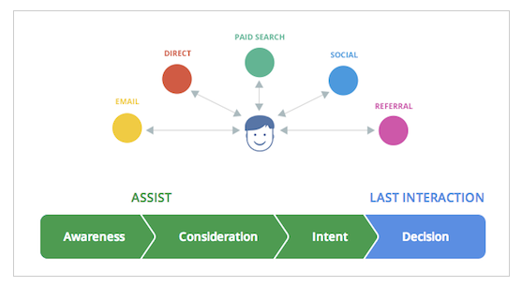
The Customer’s Journey to Online Purchase
Steps in a customer’s buying decision
Multiple “channels”, multiple interactions before purchase
A channel may be more important in “Assist” or “Last interaction” (conversion)
Data collected from 36k businesses using Google Analytics
Source: http://analytics.blogspot.com/2013/04/introducing-customer-journey-to-online.html

Slide 4
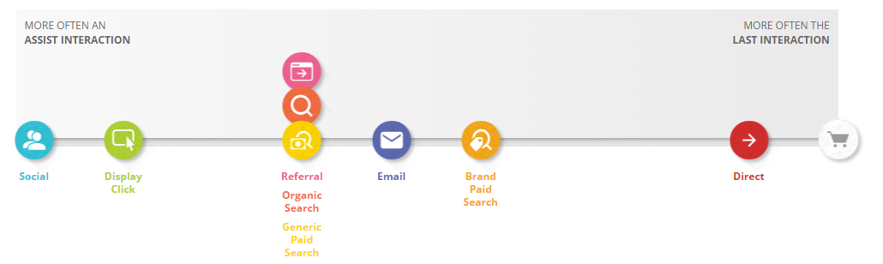
What Roles Do Social Conversations Play?
Assist interaction: Any interaction that is on the conversion path but is not the last interaction.
Last interaction: The interaction that immediately precedes the conversion (i.e., clicking on the buy button).
Assist/Last interaction ratio = # times a channel was used in assist interaction / # times the channel was used for last interaction
E.g., in automotive, users visited bmw site 30k times from a social site (e.g., Edmunds.com forum).
26.5k times the user did not buy immediately, but came back later from another channel (say, paid search link) and bought.
3.5k times users came from a social channel and bought immediately.
Assist/Last interaction = 26.5/3.5 = 7.57 (much more of an assist role)
Assist/Last interaction > 1
Assist/Last interaction < 1

Slide 5














Which Associations are Strong?
Copyright Anitesh Barua 2017

Slide 6
Co-occurrence of Terms
Going beyond Wordclouds: What metrics can we use to understand online conversations?
Do terms or words appear together by chance or due to association?
E.g., is Volvo more likely to mentioned in conjunction with safety related words than Toyota?
Is Honda more likely to be associated with reliability than, say, Jaguar?
Lift(A,B) = P(A & B) / (P(A)*P(B))
If > (<1) 1, association is stronger (weaker) than what is expected by chance

Slide 7
An Example from Edmunds.com
 | Toyota Camry | Volvo S40
# mentions | 34,559 | 580
# co-mentions with safety related words | 379 | 30
Lift of make/model & safety related words
Total # messages: 868,174 (assume one make/model
appears only once in a message
Safety related messages: 4534

Slide 8
Beyond Pairwise Association
Do people compare Audi & BMW when they discuss performance?
Mentions
of Audi
Mentions
of BMW
#(A,B,P)
Mentions of
Performance
All Mentions

Slide 9
Conditional Lift
L(x,y|z) = P(x,y|z)/[P(x|z)*P(y|z)]
= [#(x,y,z)/#(z)] / [{#(x,z)/#(z)}*{#(y,z)/#(z)}]
= [#(x,y,z)*#(z)] / [#(x,z)*#(y,z)]
E.g., L(Audi, BMW|performance) =
[#(Audi, BMW, performance)*#(performance)] / [#(Audi,performance)*#(BMW,performance)]
Perf: 500; Audi & perf: 250; BMW & perf: 300; Audi, BMW & Perf: 200
L(A,B|P) = (200*500)/(250*300) = 1.33

Slide 10
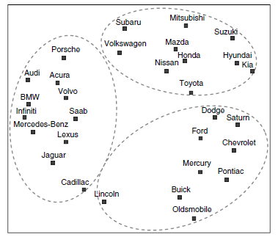
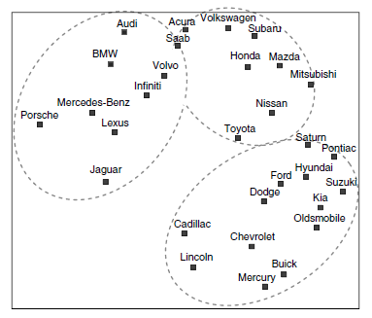
Can We Predict Switching Behavior?
Forum co-mentions
Actual brand switching

Slide 11
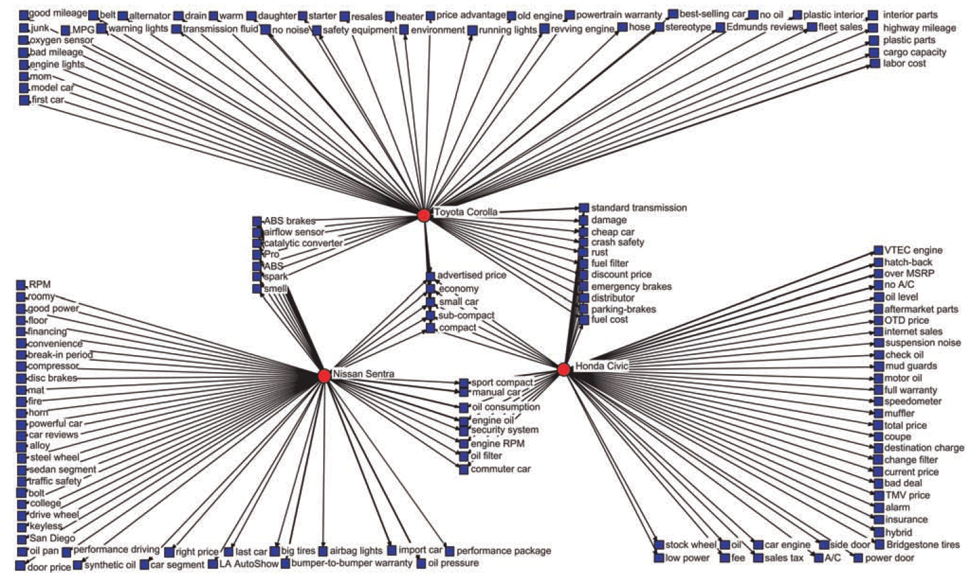
Product Attribute Associations

Slide 12
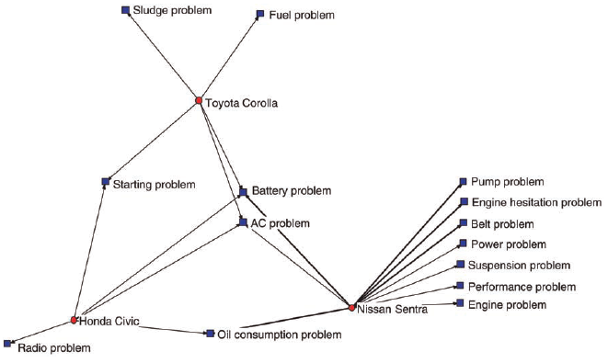
Negative Perceptions

Slide 13
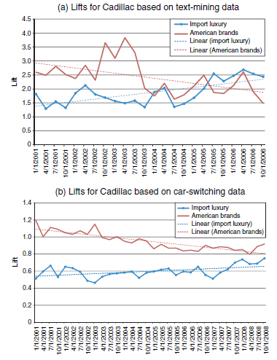
Tracking a brand

Slide 14
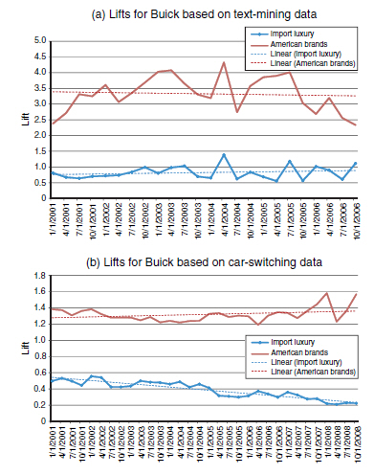
What about Buick?

Slide 15
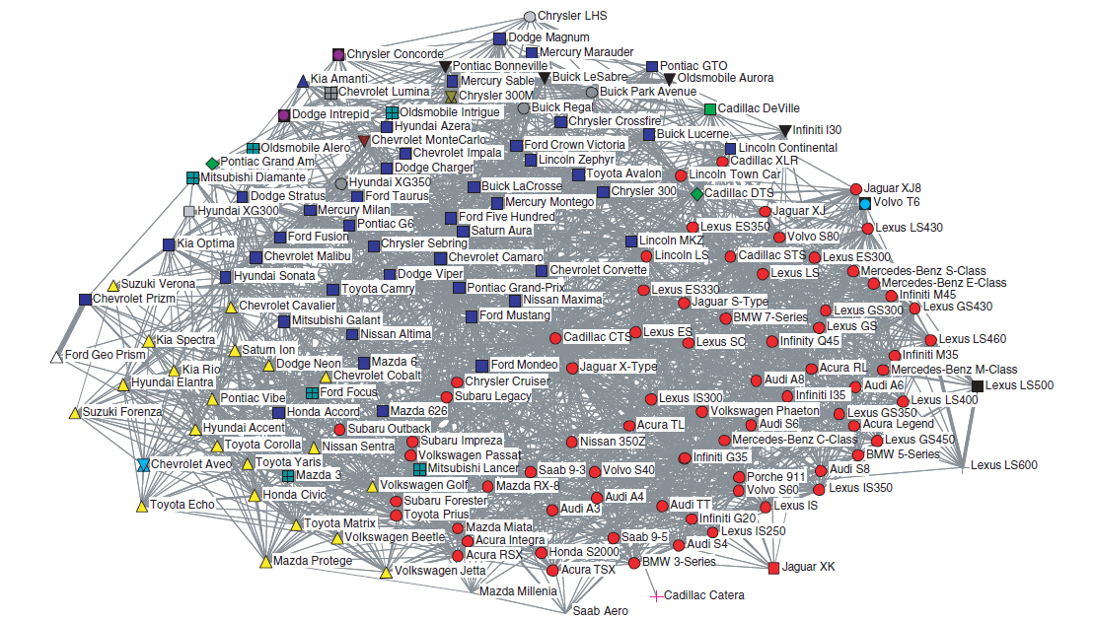
Co-mentions of Make/Models from Edmunds.com Sedan Forums

Slide 16
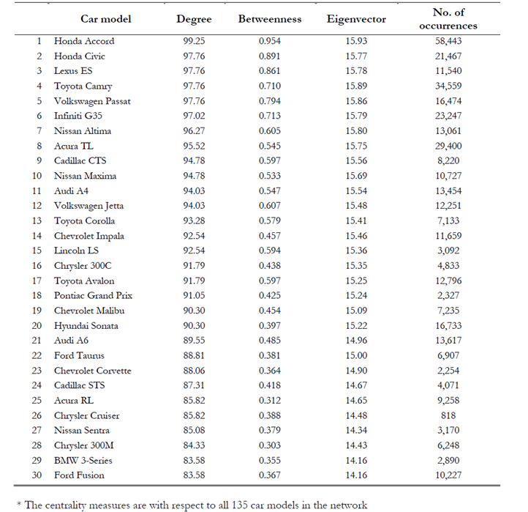

Slide 17
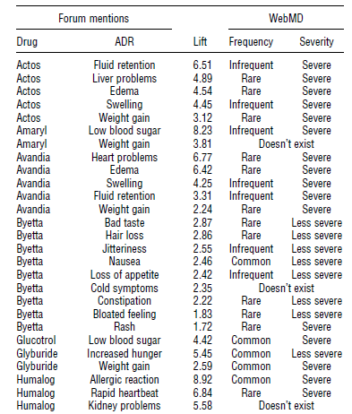
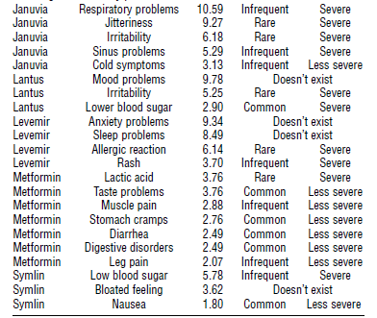
Crowds Vs. Experts

